Slide 1
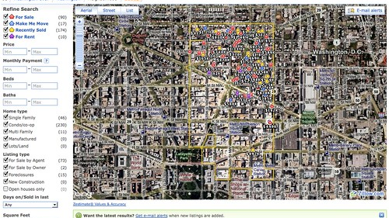
United States Housing Value Analysis over five years
Victoria Jeshurun, Christine Brown,
Doris Meiers, Lizzie Stenhaug
November 7th, 2020
This Photo by Unknown Author is licensed under CC BY-SA

Slide 2
Outlines
Project overview
Methodology & Data source
Hypothesis & questions
Group member – present findings and conclusion

Slide 3
Overview
How does unemployment rate correlate with housing prices?
How does population impact housing value?
What are the top 10 states with most increase in housing value?
What are the states with more than 25% increase in housing value?
How do different states rank in housing affordability?
What states have the longest & shortest days pending on Zillow?
Do the seasons affect the inventory and the price of the houses in the us?

Slide 4

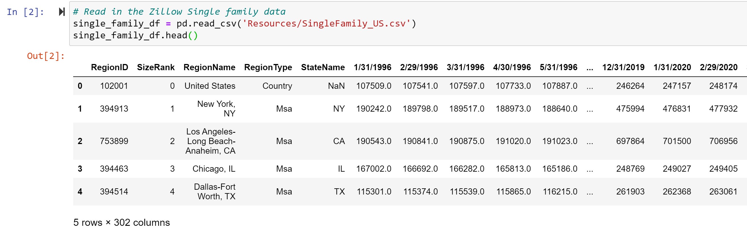
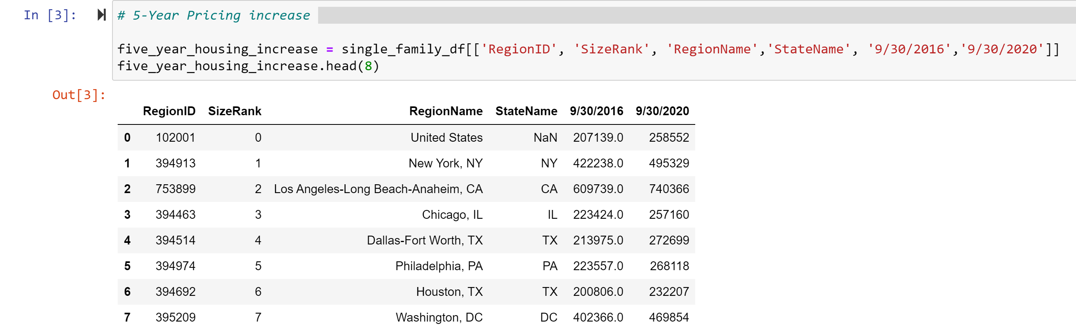
Data cleanup Process

Slide 5
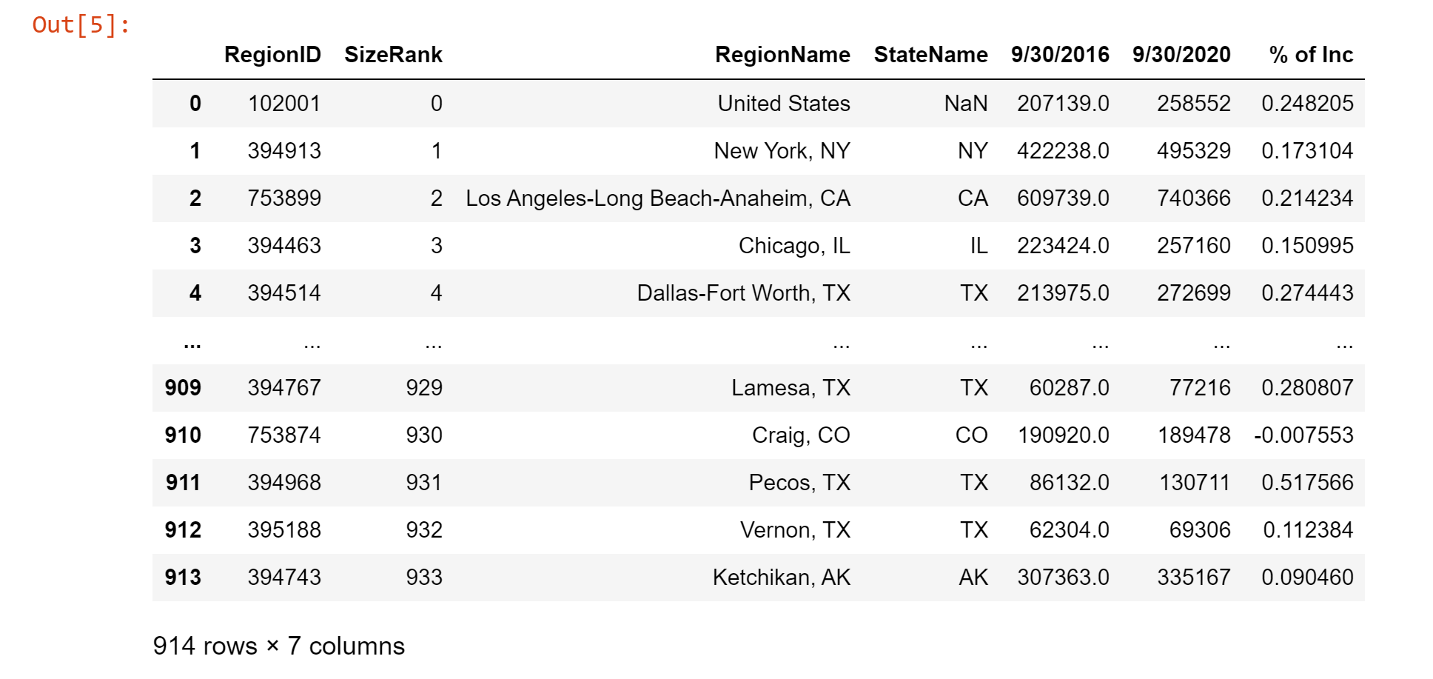
Data cleanup Process
# Calculate the % of housing pricing change

Slide 6
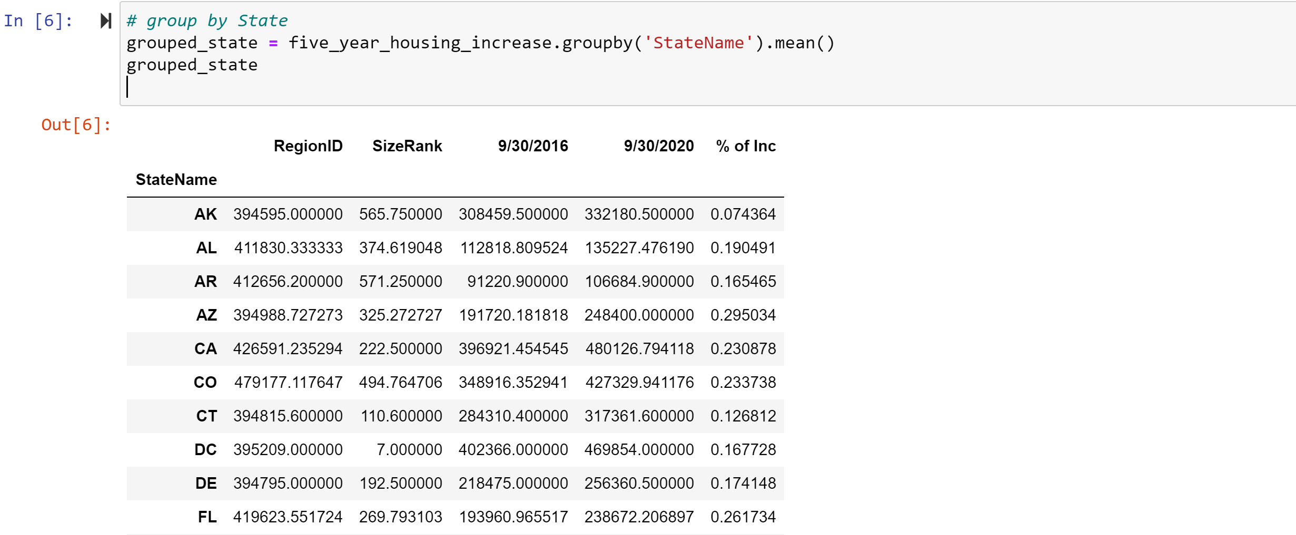
Data cleanup Process
# Group data by State

Slide 7
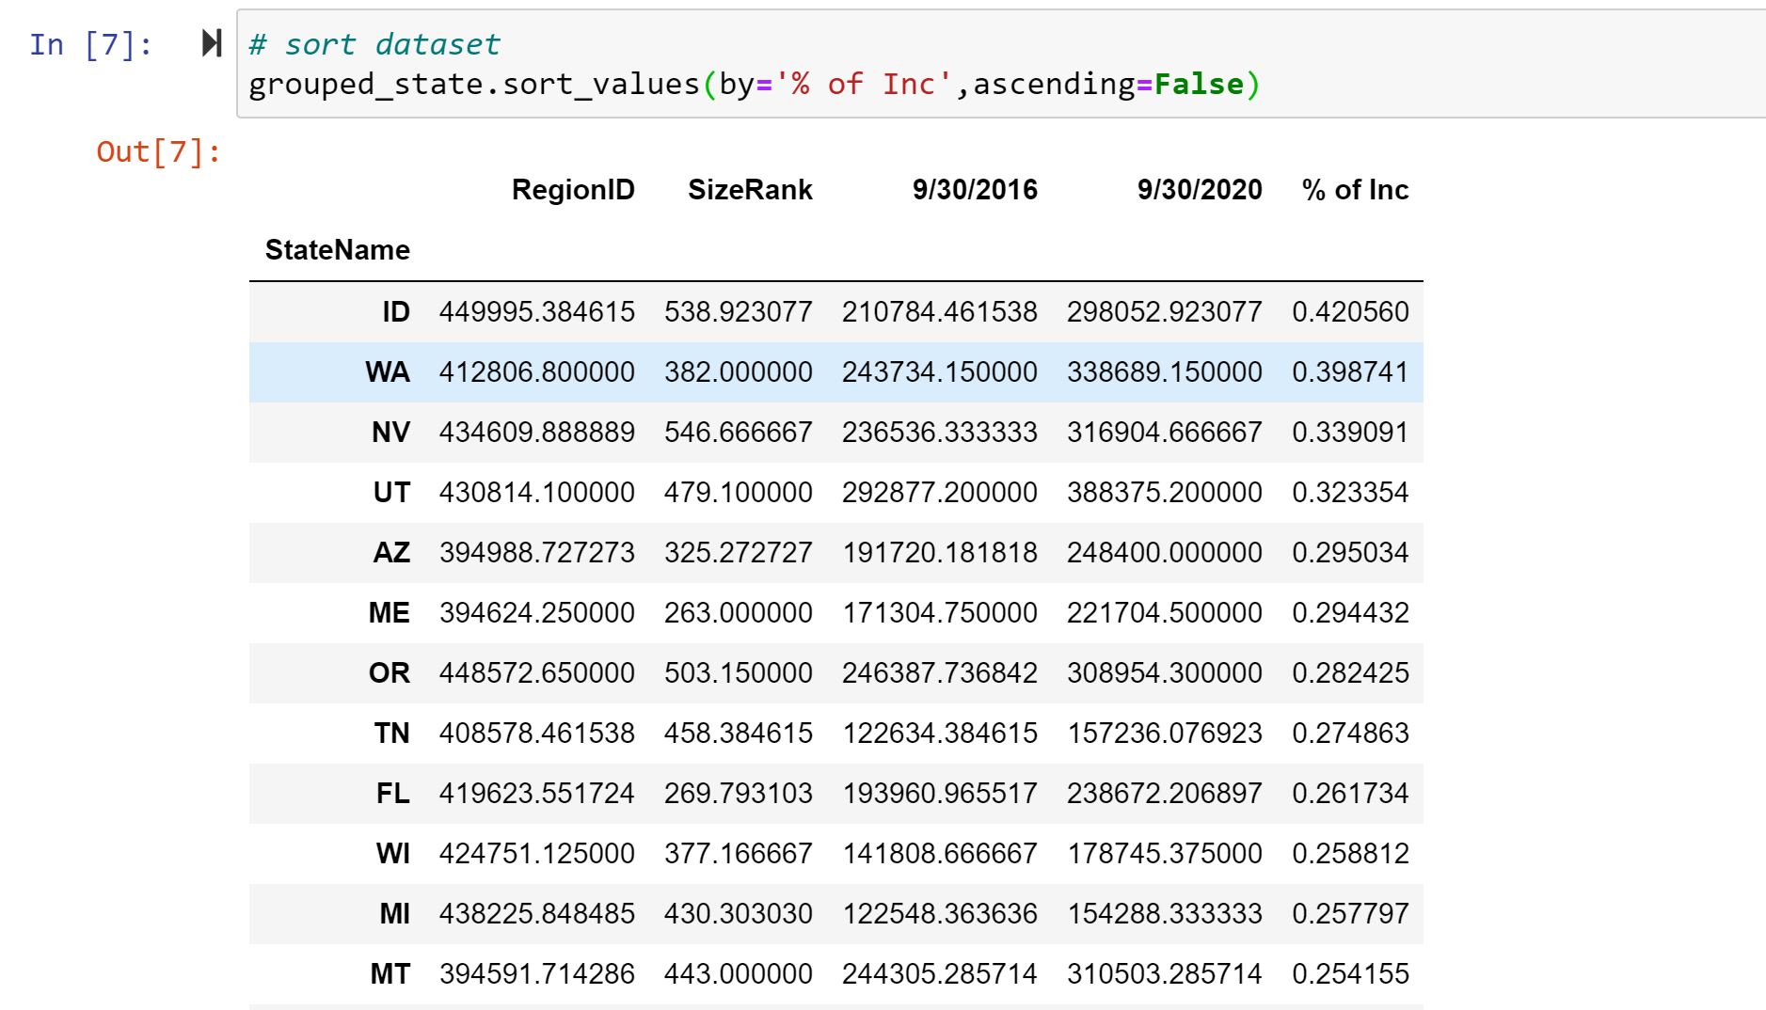
Data cleanup Process
# Sort the data by descending order

Slide 8
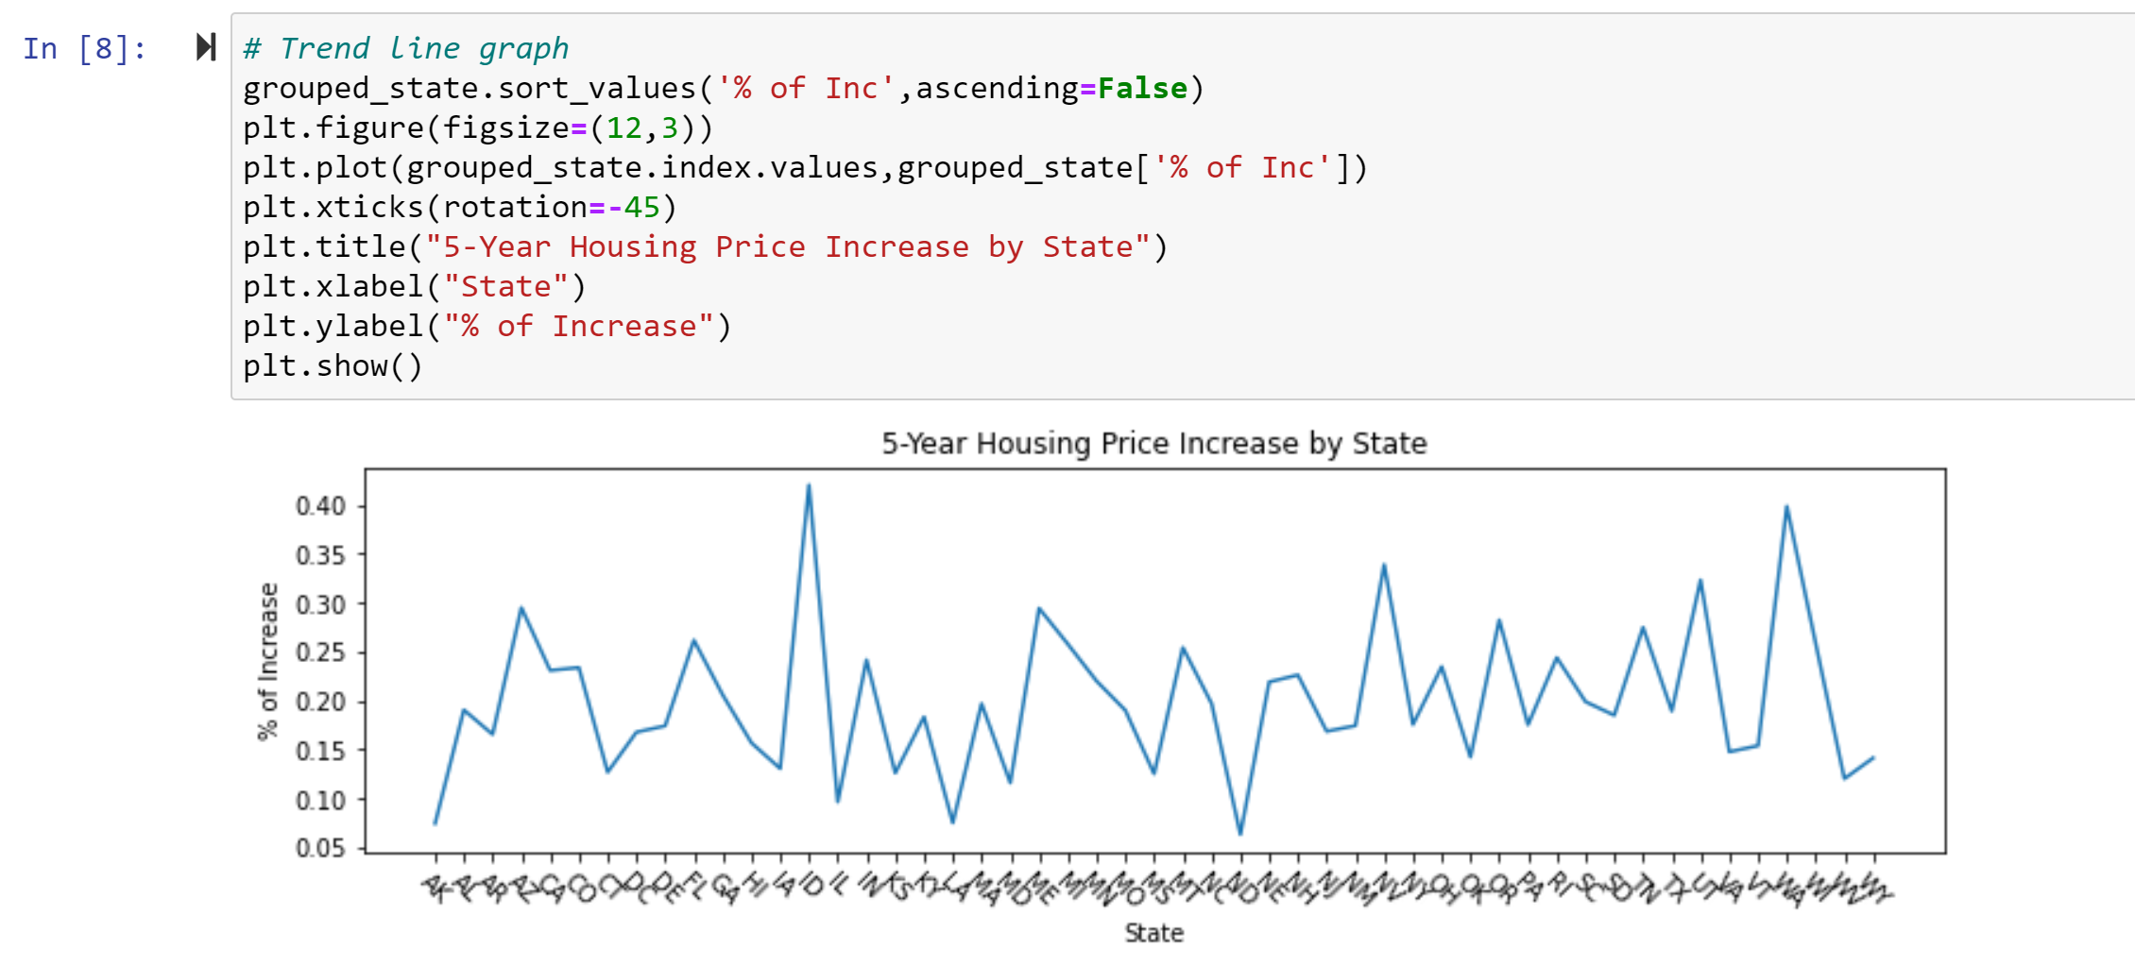
% of Change in Housing value by state
# Plot the trend line graph to show all states housing price % of change

Slide 9
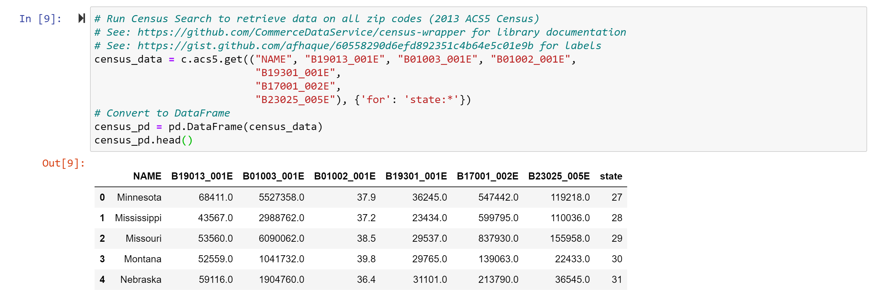
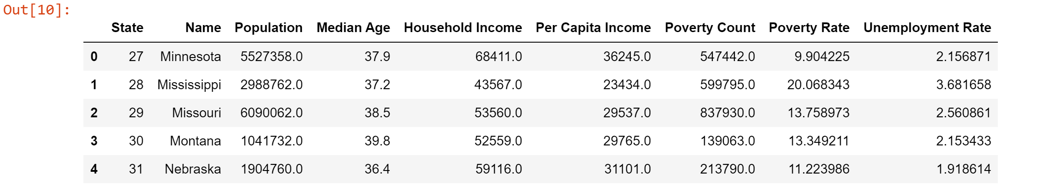
Clean up – census data
# add census data and rename the columns for easy reference

Slide 10
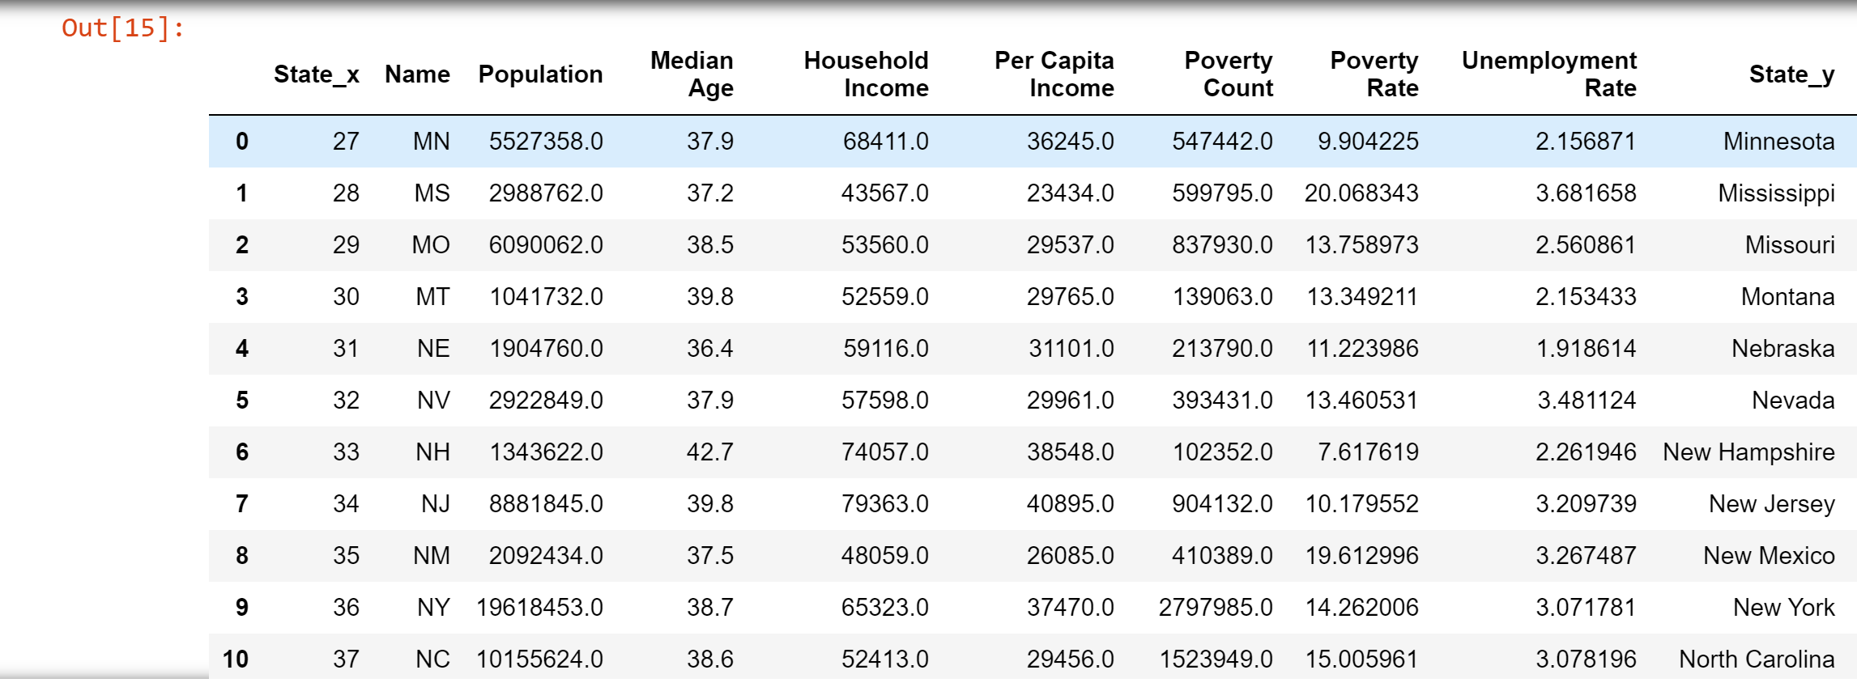
More Clean up on census data
# Rename Column into State abbreviation

Slide 11
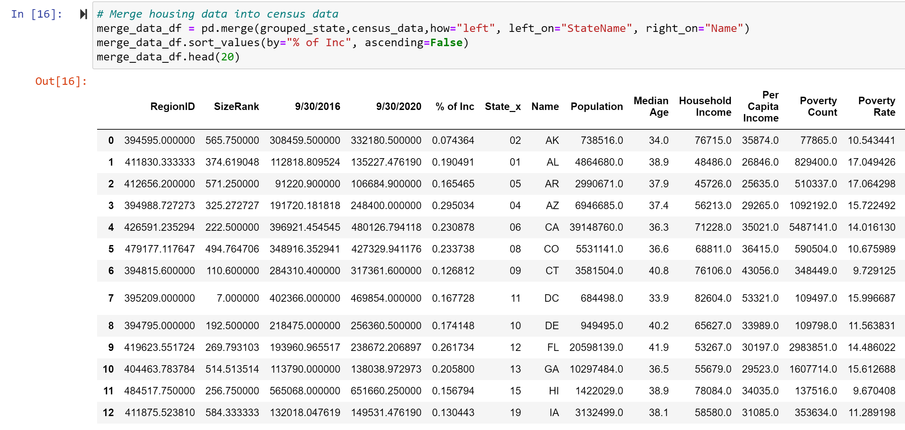
Clean up 2nd set of data points
# Merge housing data with census data

Slide 12
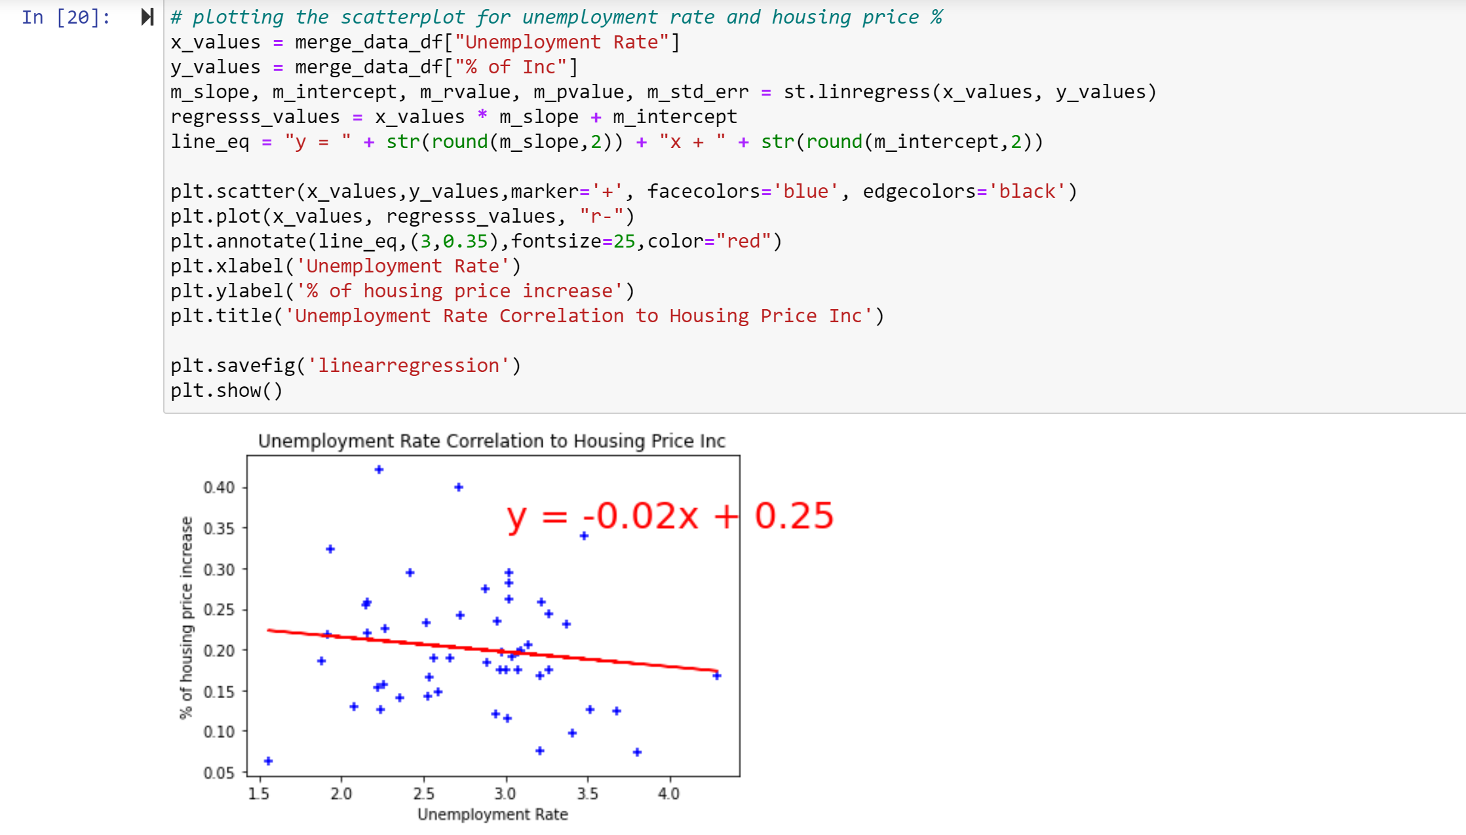
Hypothesis 1 – housing value is negatively related to unemployment rate
# correlation, scatterplot
Hypothesis is confirmed to be true.
However, the correlation is -0.13, which is not as strong as we thought it would have.
Drawback is that the census data is only for 2018. Given more time, 5-year census data would have been sourced.

Slide 13
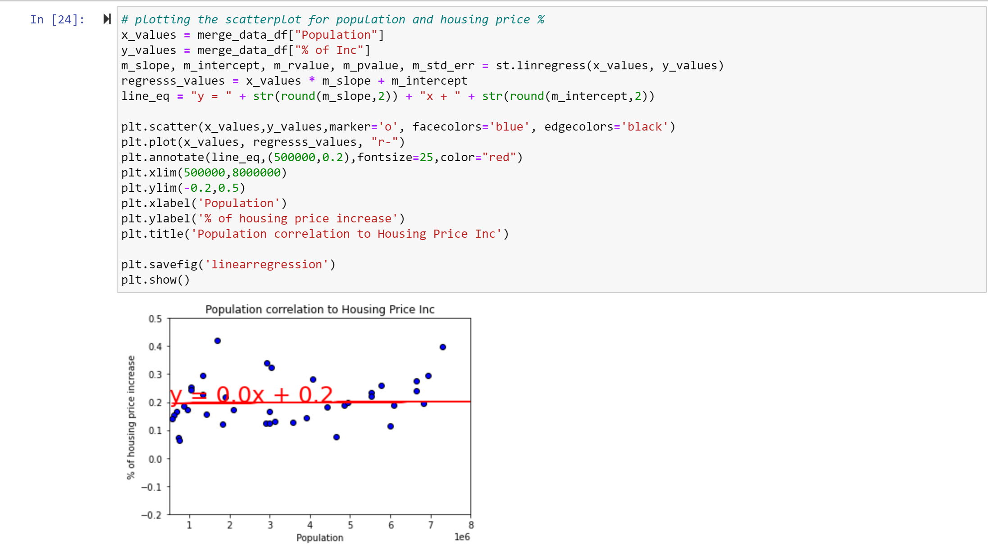
Hypothesis 2 – housing value is positively related to population
# correlation, scatterplot
Hypothesis is confirmed to be true.
However, the correlation is 0.08, which is not as strong as we thought it would have either.

Slide 14
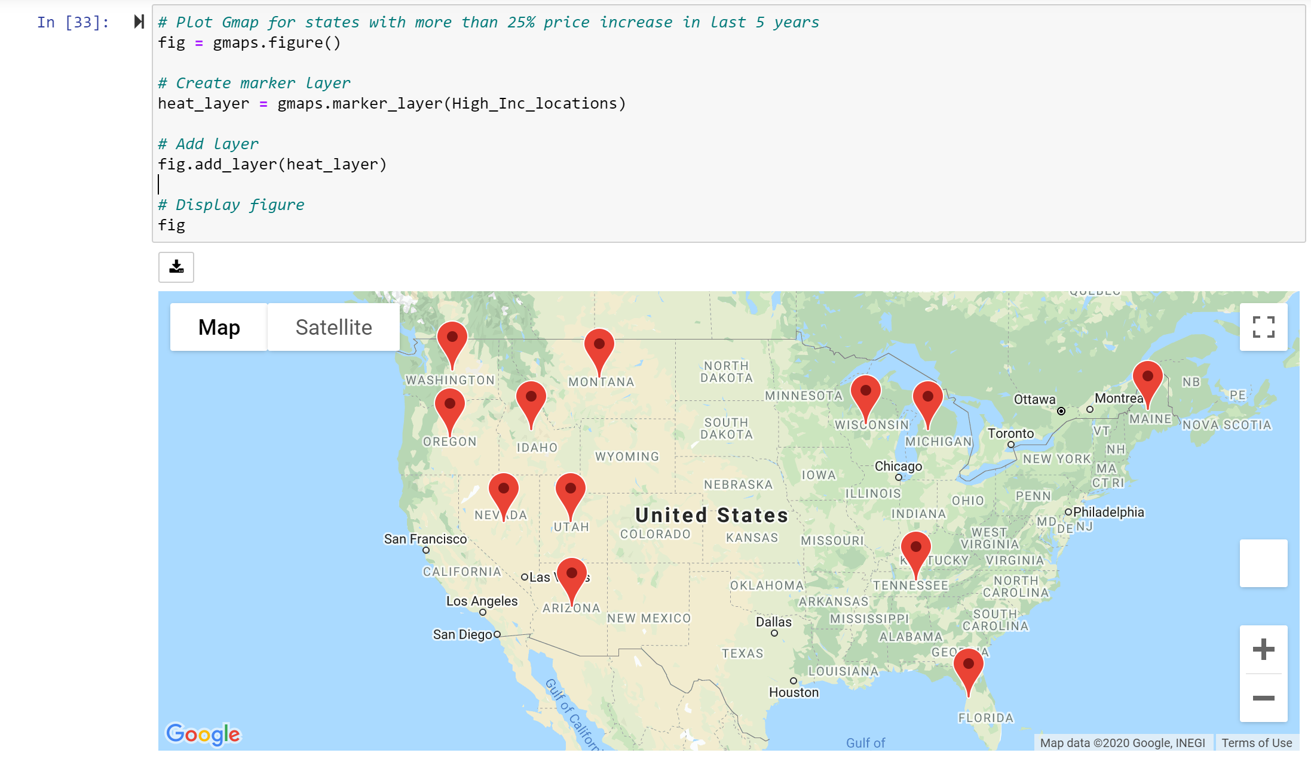
Gmaps to highlight states with more than 25% increase in house value in last 5 Years

Slide 15
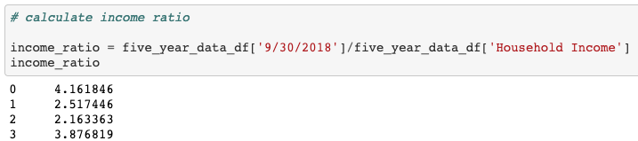
How do states rank in housing affordability?
Price To Income Ratio: Also known as P/E Ratio details the number of years a household income will be invested to purchase a home
Example: $200,000 house price vs a $50,000 a year household income
P/E Ratio = 4.0
A high housing P/E Ratio will depict an expensive housing market
P/E Ratio above 4 = poor affordability
P/E Ratio below 4 = good affordability

Slide 16
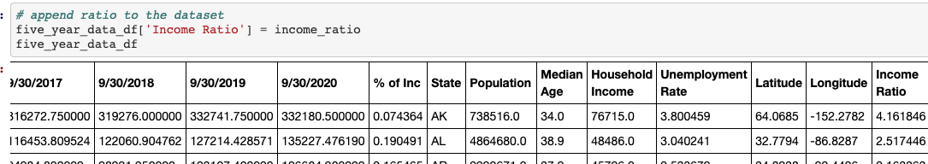
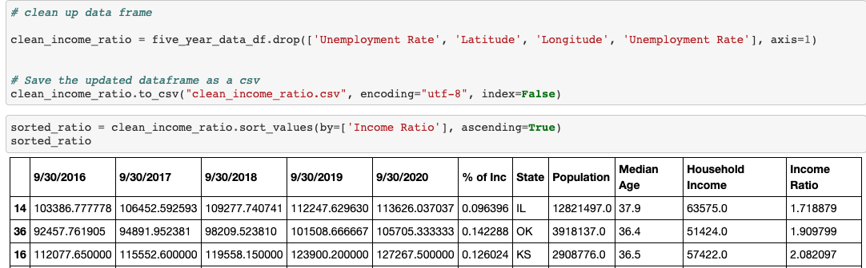
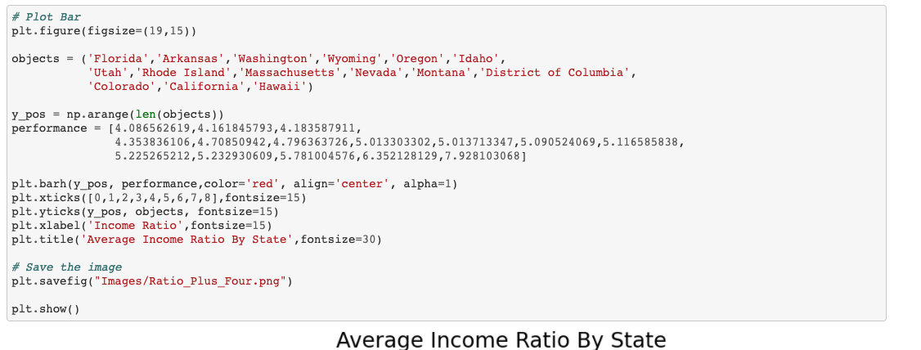
How do states rank in housing affordability?

Slide 17
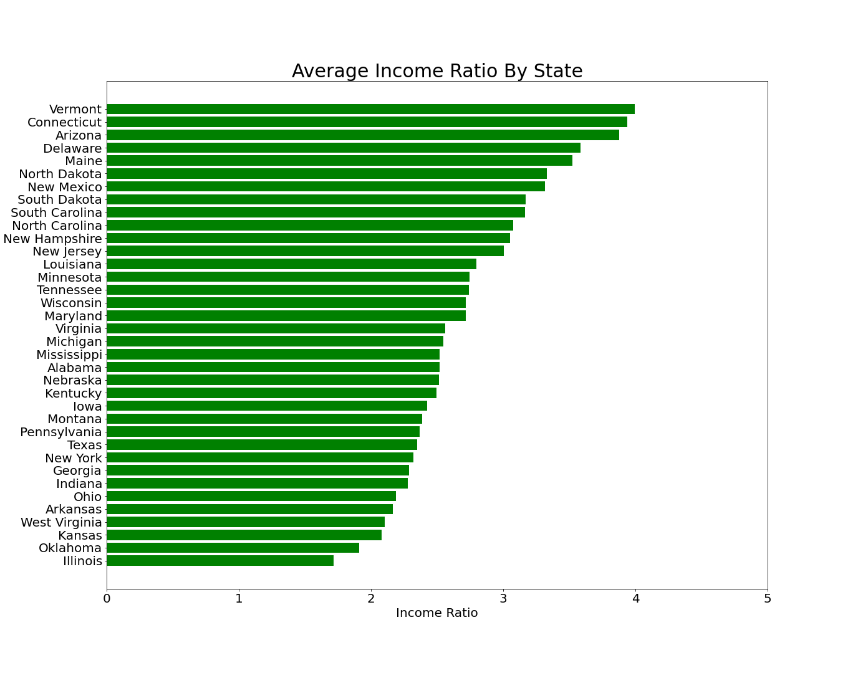
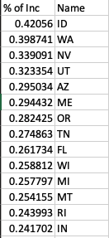
How do states rank in housing affordability?

Slide 18
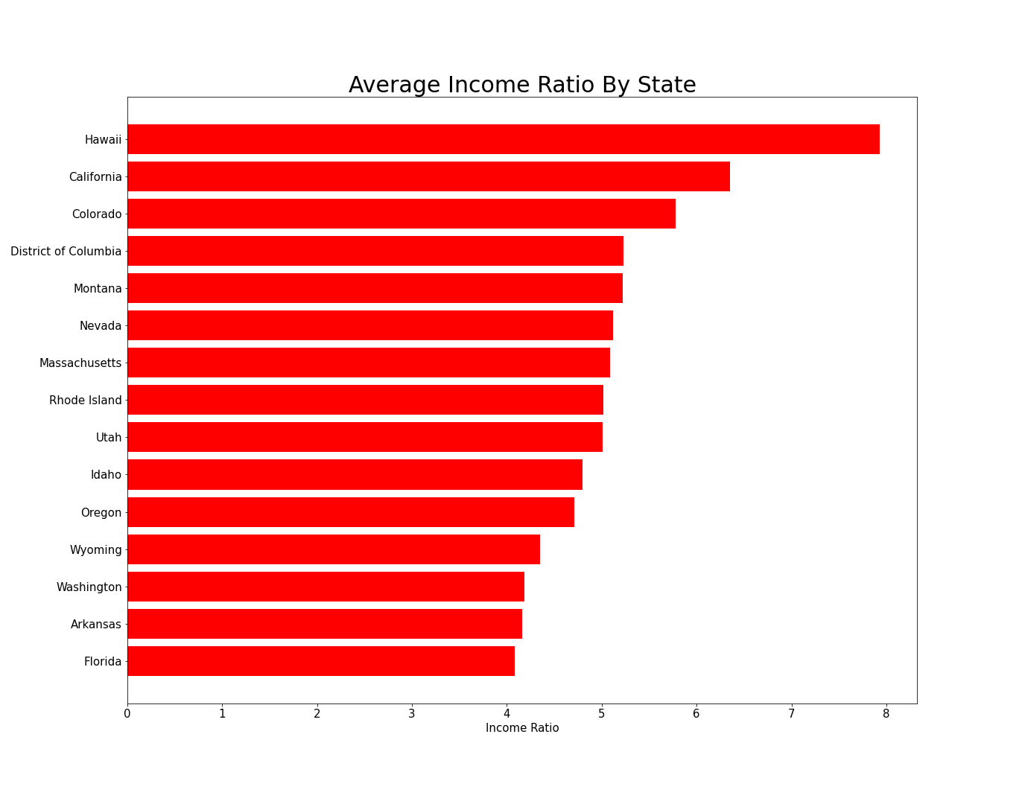
How do states rank in housing affordability?
Hypothesis – low housing affordability is relatively related to higher % increase in housing prices in the last 5 years

Slide 19
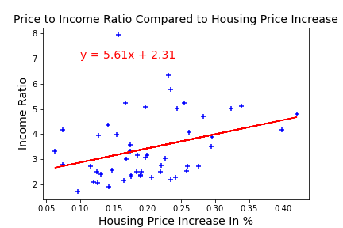
Price to income ratio summary
Highest P/E ratio: Hawaii at 7.9.
Lowest P/E ratio: Illinois at 1.7
Average P/E ratio: 3.44
Poor Affordability: Hawaii, California, Colorado, District of Columbia, Montana.
Great Affordability: Illinois, Oklahoma, Kansas, West Virginia and Arkansas.
There is a small positive correlation between income ratio and increase in housing price over 5 years but not enough to predict a trend.

Slide 20

What states have the longest & shortest days pending on zillow?
Days to Pending: How long it takes homes in a region to change to pending status on Zillow.com after first being shown as for sale. The reported figure indicates the number of days (mean or median) that it took for homes that went pending during the week being reported, to go pending. This differs from the old “Days on Zillow” metric in that it excludes the in-contract period before a home sells.

Slide 21
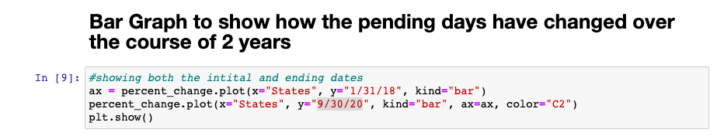
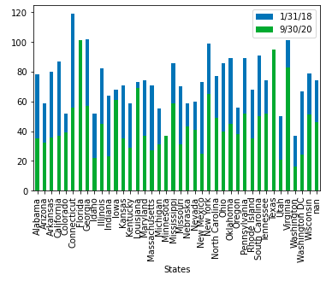
Graph to show the change over time
Blue represents the days pending for January 31, 2018
Green represents the days pending for Sept 30, 2020
Decrease in days pending over the last 2 years

Slide 22
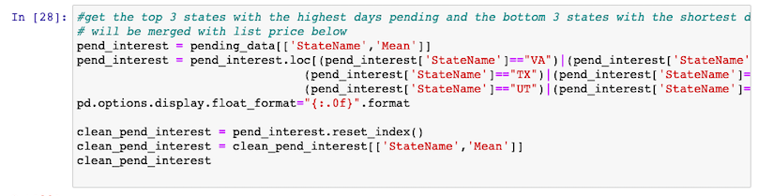
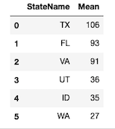
Top 3 States with the Longest Days pending & Top 3 states with the shortest Days Pending
Longest Days Pending
Shortest Days Pending

Slide 23
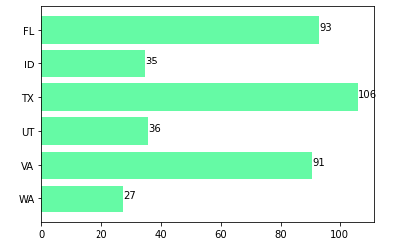
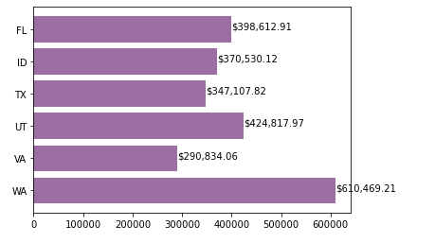
Is there a correlation between List price & Days pending?
1
1
4
4
0
0
3
3
2
2
5
5
DAYS PENDING
LIST PRICE

Slide 24
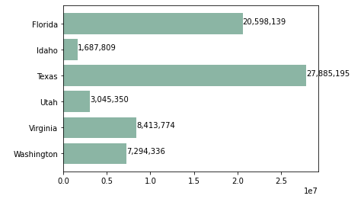
Is there a correlation between POPULATION & Days pending?
1
1
4
4
0
0
3
3
2
2
5
5
DAYS PENDING
POPULATION
Conclusion – there are a lot of factors that drive days pending.
How many houses on the market, unemployment rate, etc.
Cheaper list price does not mean the house will go off the market faster
The Larger the population the longer the house is on the market.

Slide 25
do the seasons affect the inventory and the price of the houses in the us?
Questions asked and supporting data:
Do the seasons affect the amount of the inventory?
Do the seasons affect the price of the houses?
The data pulled were csv files (Median Sale Price and For-Sale Inventory)
Supporting data was taken from Zillow’s Housing Data

Slide 26
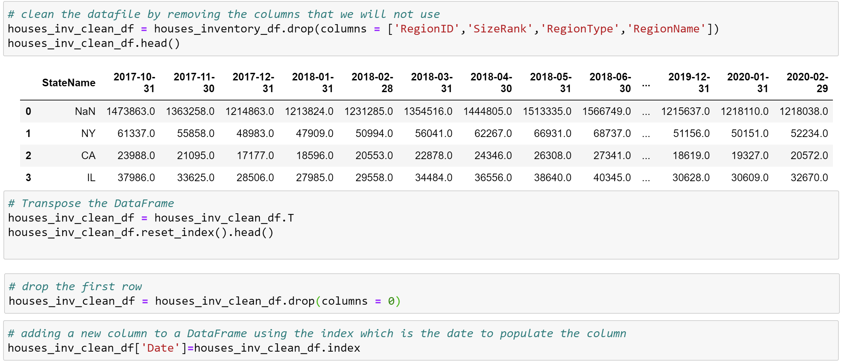
Clean up – process – inventory datafile

Slide 27
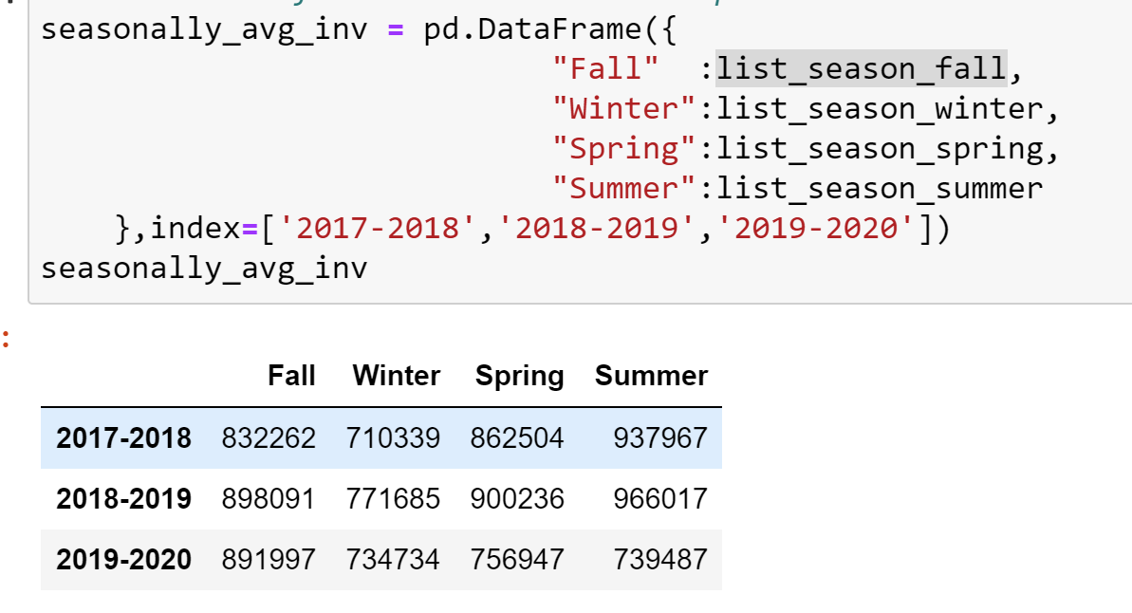







Single family- ZILLOW INVENTOY – SEASONAL 3 YEARS

Slide 28
Comparing inventories seasonally – single family homes
Each season we can see tendencies in the quantities of the inventory:
The winter inventory always decreases after fall.
The spring and summer inventory tends to increase.
This year the inventory is lower after last year’s fall.
This indicates that the inventory is affected by the seasons, although this year shows something different and this could be because of the pandemic.

Slide 29
Clean up – process – house sale prices datafile

Slide 30
Comparing prices seasonally – single family homes
Each season we can see tendencies in the prices:
In winter the prices tend to decrease.
In spring the prices increase.
Summer and fall tend to increase the same as spring.
This indicates that the prices are also affected by the season although overall the prices continue to increase.

Slide 31
Comparing prices seasonally – single family homes
Every winter is a low price point and increases in spring.

Slide 32
Comparing prices seasonally – southern and northern states
The two Southern states (NV and FL) show a more linear trend.
The two Northern states (MN and WI) show that the house prices are more affected by the seasons.

Slide 33
Conclusion
Small positive correlation is found between high income ratio and increase in housing price over 5 years but not significant enough to predict a trend.
Unemployment rate is negatively correlated to housing value but in a less strength as predicted.
Cheaper list price does not mean the house will go off the market faster & the larger the population more slowly the house is sold.
Seasonality affects the inventories and the housing value but the magnitude varies from state to state.
Housing inventories tend to decrease in winter and increase in warmer temperatures.
Finally, we can conclude that the seasons affect both prices and inventories, but this depends on the location of the state.

Slide 34


